Slide 1
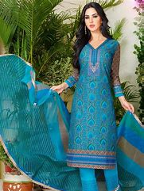
MY SUIT
website

Slide 2
Team Member
Ajinkya Gagare
Harshvardhan Shirole
Jagdeep Kaur
Manpreet Kaur

Slide 3
Description
Everyone want to save a time in modern era so ,our website MY suit help them.
Purpose: every one buy a suit online from anywhere with all demands.
About: Indian dress as well as some western dresses also some corner is
about jewellery and bags.
Suits category: Party wear
casual
semi-formal
western dresses

Slide 4
Cont.
Requirement: customer requirement like measurement
Catalogue: customer know about trend
Shopping cart
Login ad sign up
Social link
Payment method
Maximum Clarity

Slide 5
Alpha-Release
According to the Client agreement in the alpha release we deliver the proper design of home page with the functionality and requirement like
Sign Up
Login
Shopping cart
website link :

Slide 6
Client Acceptance
Client meeting: before the shopping cart development we met client .
Where: James cook university Brisbane at 4th level
Client review: he need some changes in designing and want other user
stories .
After user stories and changing designing meeting:

Slide 7
Plan for Beta
user stories | Priority
Size Guide | 10
Check out | 10
Remove item from cart | 20
Other pages designing pictures | 20

Slide 8
Plan for Final
User stories | priority
Self guide | 20
Email sent directly to client | 20
Order track | 10
Social media | 40

Slide 9
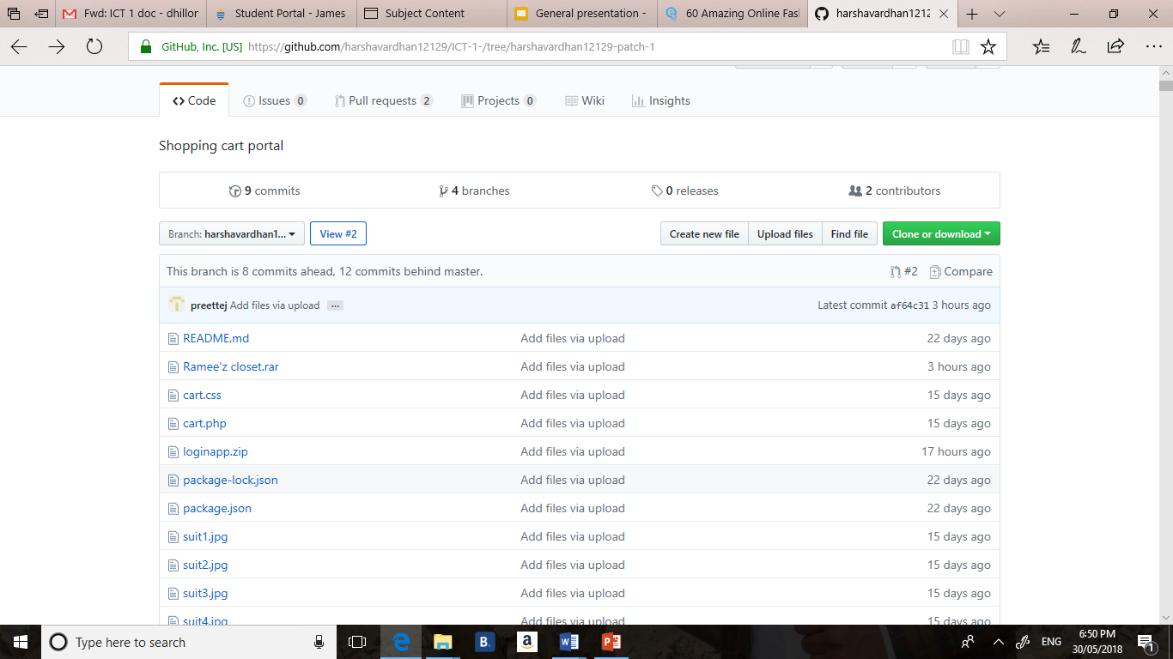
Project development, ICT infrastructure
For front end : we use a HTML 5, CSS, bootstrap, react
Backend : node js
GitHub: All team member push their code in GitHub for sharing each other

Slide 10
THANKS FOR LISTENING

